Slide 1
JS day 3
functional programming
objects in javaScript

Slide 2
Functions
Functions are defined by using the reserved word function and then the function name and (optional) parameters.
Functions do not require a return type, nor do the parameters require type specifications.

Slide 3
Declaring and calling functions
A function to calculate a subtotal as the price of a product multiplied by the quantity might be defined as follows:
function subtotal(price,quantity) {
return price * quantity;
}
The above is formally called a function declaration. Such a declared function can be called or invoked by using the () operator.
let result = subtotal(10,2);

Slide 4
Function expressions
The object nature of functions can be further seen in the next example, which creates a function using a function expression.
// defines a function using an anonymous function expression
const calculateSubtotal = function (price,quantity) {
return price * quantity;
};
// invokes the function
let result = calculateSubtotal(10,2);
// define another function
const warn = function(msg) { alert(msg); };
// now invoke that function
warn("This doesn't return anything");
LISTING 8.11 Sample function expressions

Slide 5
Objects
We have already encountered a few of the built-in objects in JavaScript, namely, arrays along with the Math, Date, and document objects.
In this section, we will learn how to create our own objects and examine some of the unique features of objects within JavaScript.
In JavaScript, objects are a collection of named values (which are called properties in JavaScript).
Unlike languages such as C++ or Java, objects in JavaScript are not created from classes. JavaScript is a prototype based language, in that new objects are created from already existing prototype objects.

Slide 6
Object Creation Using Object Literal Notation
The most common way is to use object literal notation (which we also saw earlier with arrays)
An object is represented by a list of key-value pairs with colons between the key and value, with commas separating key-value pairs.
To reference this object’s properties, we can use either dot notation or square bracket notation.
const objName = {
name1: value1,
name2: value2,
// ...
nameN: valueN
};
objName.name1
objName["name1"]

Slide 7
DOM
Når browseren loader websiden, skaber den sidens 'DOM’,
der står for
Document
Object Model.
DOM er en struktureret model af websiden,
en træ-struktur opsætning, som du kender fra f.eks. Windows stifinder.

Slide 8
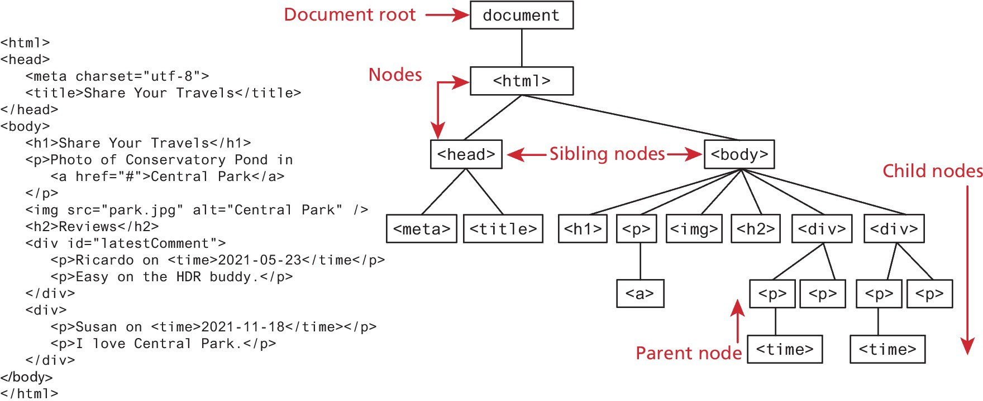
The Document Object Model (DOM)

Slide 9
Document Object
The DOM document object is the root JavaScript object representing the entire HTML document. It is globally accessible via the document object reference.
The properties of a document cover information about the page. Some are read-only, but others are modifiable. Like any JavaScript object, you can access its properties using either dot notation or square bracket notation
// retrieve the URL of the current page
let a = document.URL;
// retrieve the page encoding, for example ISO-8859-1 let b = document["inputEncoding"];

Slide 10
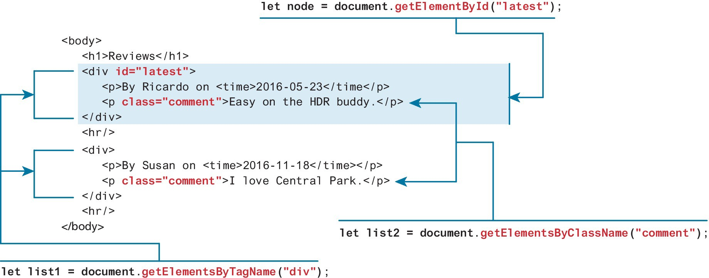
Selection Methods
The most important DOM methods
They allow you to select one or more document elements. The oldest 3 are: getElementById("id"), getElementsByClassName("name") and getElementsByTagName("name")

Slide 11
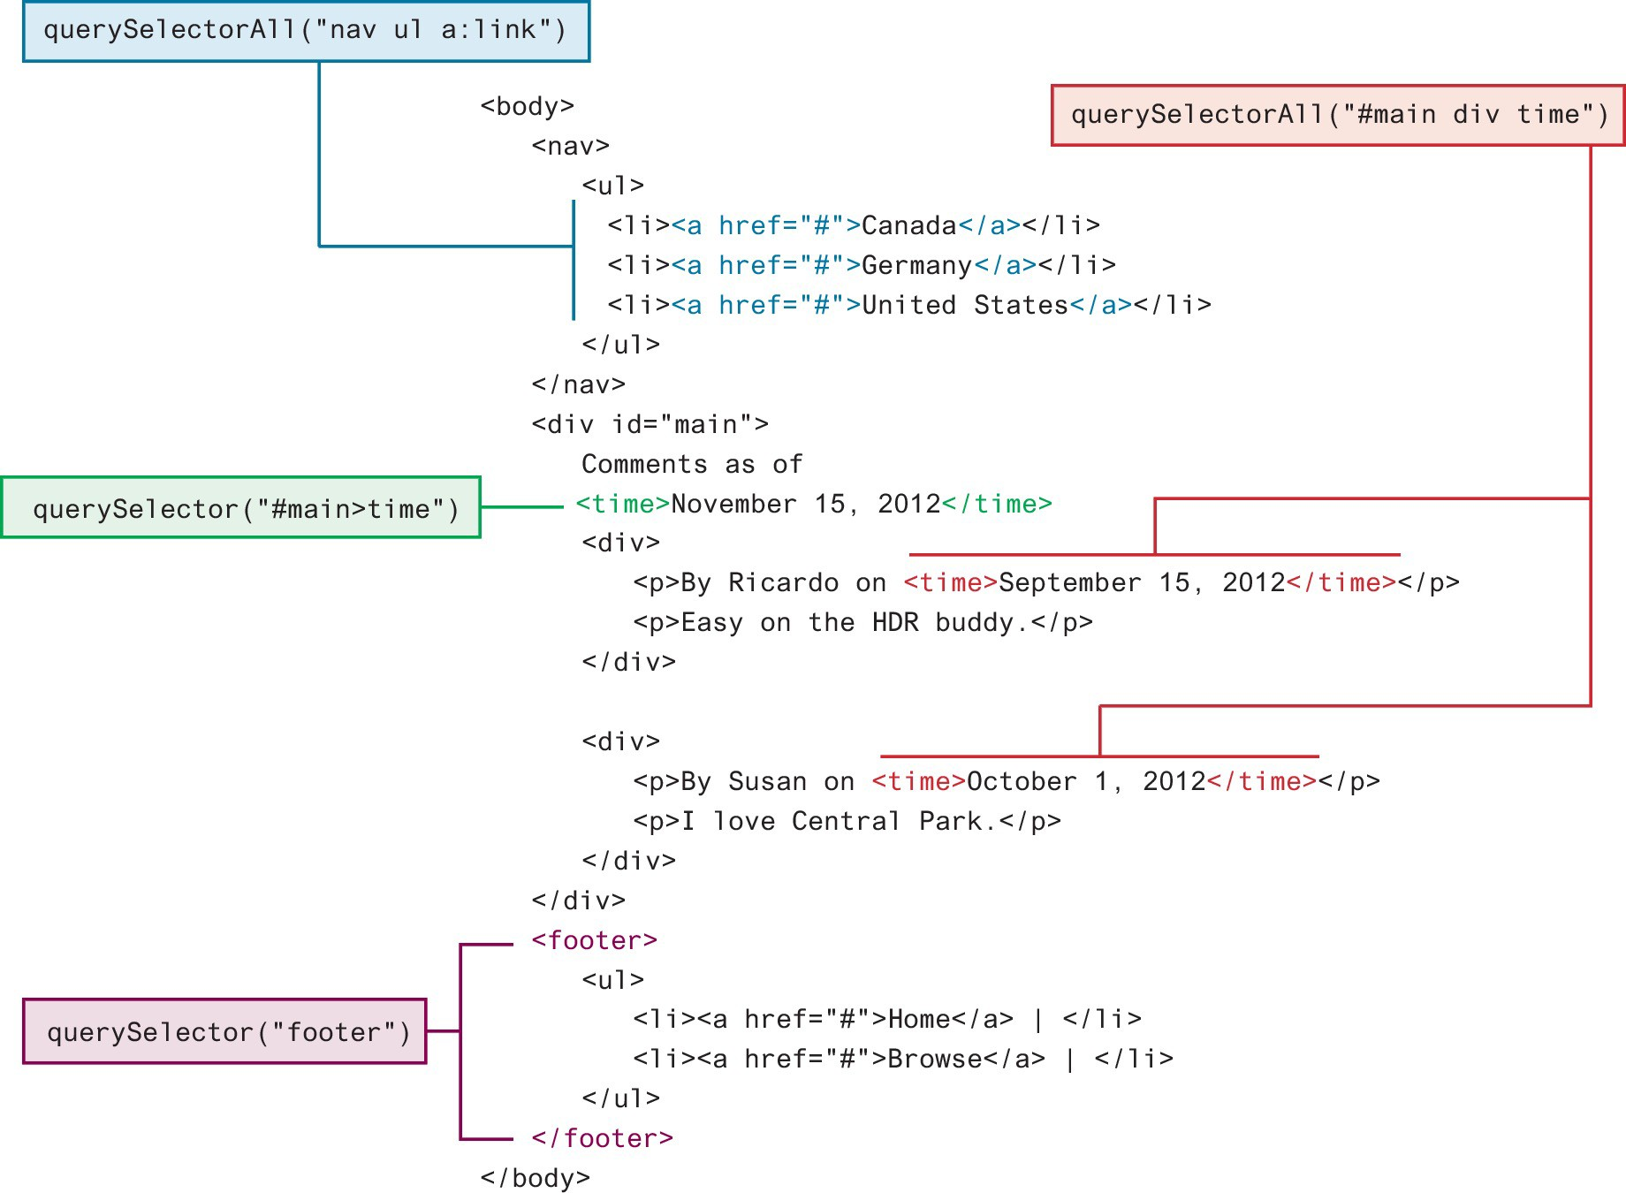
Query Selection Methods(recommend)
The newer querySelector() and querySelectorAll() methods allow you to query for DOM elements much the same way you specify CSS styles

Slide 12
Some Essential Element Node Properties
classList A read-only list of CSS classes assigned to this element. This list has a variety of helper methods for manipulating this list.
className The current value for the class attribute of this HTML element.
id The current value for the id of this element.
innerHTML Represents all the content (text and tags) of the element.
style The style attribute of an element. This returns a CSSStyleDeclaration object that contains sub-properties that correspond to the various CSS properties.
tagName The tag name for the element.

Slide 13
Changing an Element’s CSS Style
To programmatically modify the styles associated with a particular element one must change the properties of the style property for that element
For instance, to change an element’s style, we could use the following code:
https://www.w3schools.com/js/tryit.asp?filename=tryjs_change_style

Slide 14
DOM Manipulation-HTML
For instance, you could change the content of the <div> in using the following:
const div = document.querySelector("#main"); div.innerHTML = '<a href="#"><img src="ab.gif"></a>’;
This replaces the existing content with the new content.

Slide 15
DOM Manipulation Methods
appendChild Adds a new child node to the end of the current node.
createAttribute Creates a new attribute node.
createElement Creates an HTML element node.
createTextNode Creates a text node.
insertAdjacentElement Inserts a new child node at one of four positions relative to the current node.
insertAdjacentText Inserts a new text node at one of four positions relative to the current node.
insertBefore Inserts a new child node before a reference node in the current node.
removeChild Removes a child from the current node.
replaceChild Replaces a child node with a different child.

Slide 16

DOM Event

Slide 17
DOM loading
Before finishing this section on using the DOM, it should be emphasized that the timing of any DOM code is very important.
You cannot access or modify the DOM until it has been loaded.
To wait until we know for sure that the DOM has been loaded requires knowledge from our next section on event handling.

Slide 18
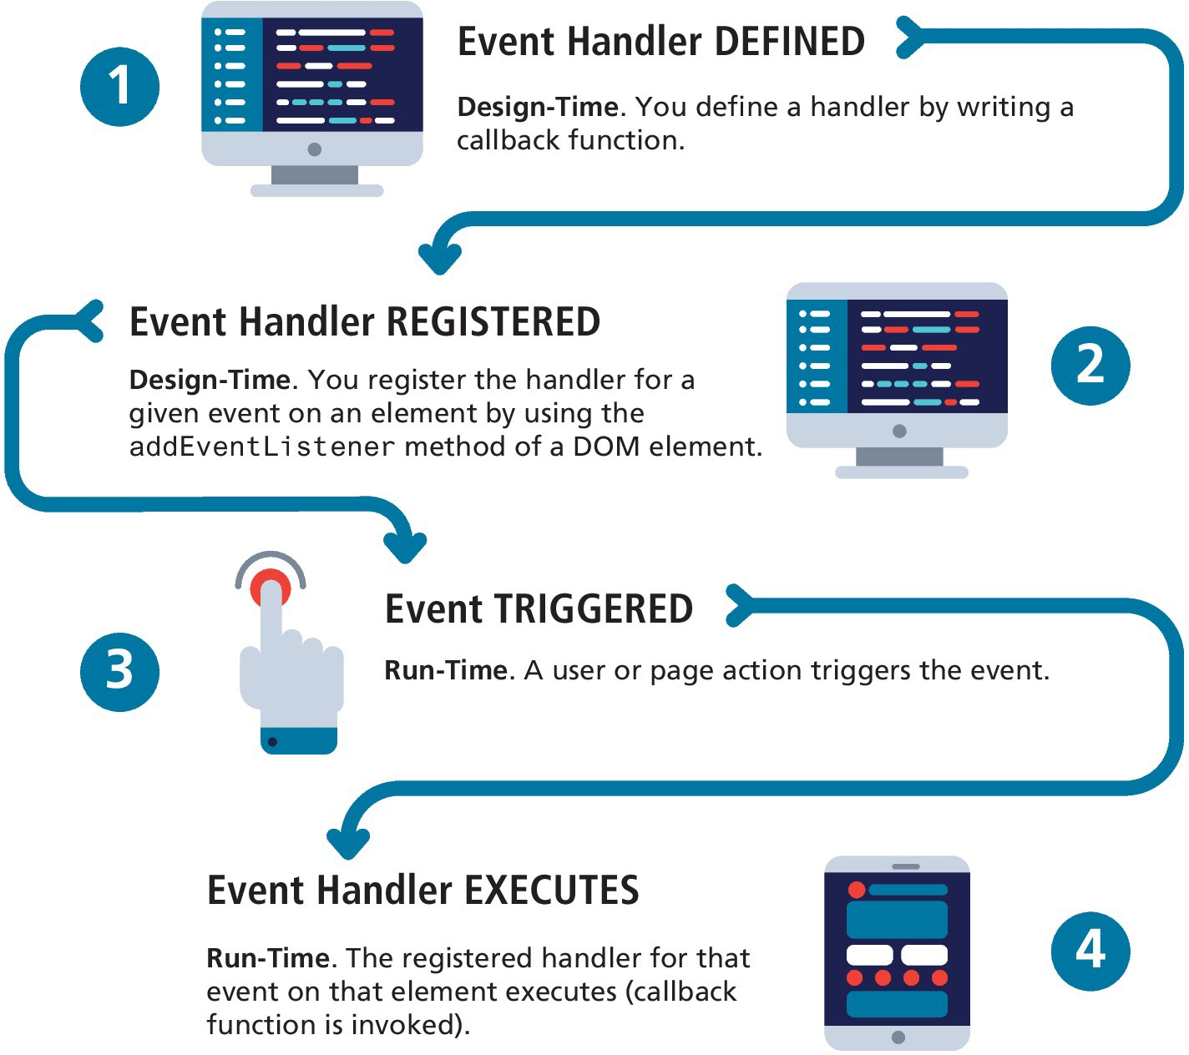
JavaScript Event Handling

Slide 19
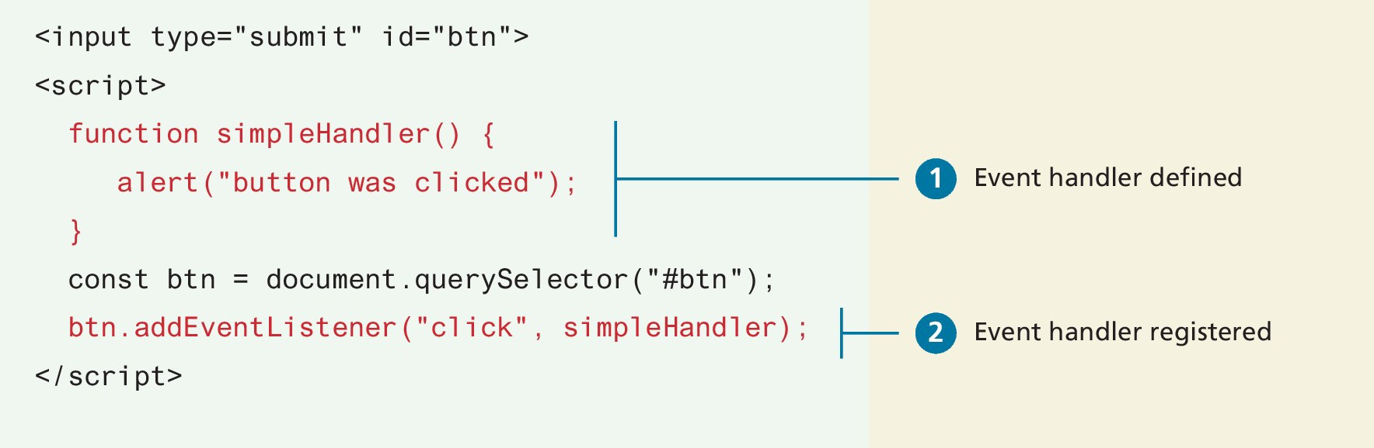
Implementing an Event Handler
An event handler is first defined, then registered to an element node object.
Registering an event handler requires passing a callback function to the addEventListener()

Slide 20
Event Types
There are many different types of events that can be triggered in the browser.
Perhaps the most obvious event is the click event, but JavaScript and the DOM support several others.
In actuality, there are several classes of event, with several types of events within each class specified by the W3C. Some of the most commonly used event types are:
mouse events,
keyboard events,
touch events,
form events, and
frame events.

Slide 21
Mouse Events
click The mouse was clicked on an element.
dblclick The mouse was double clicked on an element.
mousedown The mouse was pressed down over an element.
mouseup The mouse was released over an element.
mouseover The mouse was moved (not clicked) over an element.
mouseout The mouse was moved off of an element.
mousemove The mouse was moved while over an element.

Slide 22
Try yourself
https://www.w3schools.com/jsref/tryit.asp?filename=tryjsref_onclick_addeventlistener

Slide 23
Form Events
blur Triggered when a form element has lost focus (i.e., control has moved to a different element), perhaps due to a click or Tab key press.
change Some <input>, <textarea>, or <select> field had their value change. This could mean the user typed something, or selected a new choice.
focus Complementing the blur event, this is triggered when an element gets focus (the user clicks in the field or tabs to it).
reset HTML forms have the ability to be reset. This event is triggered when that happens.
select When the users selects some text. This is often used to try and prevent copy/paste.
submit When the form is submitted this event is triggered. We can do some prevalidation of the form in JavaScript before sending the data on to the server.

Slide 24
demo
Autocomplete form
https://www.w3schools.com/howto/tryit.asp?filename=tryhow_js_autocomplete

Slide 25
Case opgave

